Slide 1

Vendor & Supplier
Management System
Project Presentation — React.js, Spring Boot & MySQL
Student Name | Class / Roll No. | Date

Slide 2


Introduction
Full-stack web app: React.js frontend with a Java Spring Boot backend
Secure login with Admin and User roles
Manages vendors, suppliers, products, requests, quotations and orders
All data stored in a MySQL database through REST APIs
Vendors & Suppliers
Maintain partner records
Products
Catalog and pricing
Request to Order
Requests, quotations, orders

Slide 3
Objectives
1
2
3
Build a responsive React.js frontend
Develop REST APIs with Java Spring Boot
Store and manage data in a MySQL database
4
5
6
Secure access with login and role-based control
Handle CRUD with Axios and React Router
Manage the flow: request, quotation, purchase order

Slide 4
Technologies Used
React.js
Vite
React Router DOM
Axios
Frontend UI
Build tool
Page navigation
API requests
Java Spring Boot
MySQL
Spring Data JPA
Spring Security
REST backend
Relational database
Database access (ORM)
Login, JWT and roles

Slide 5






Modules
Login
Dashboards
Vendors
Secure JWT sign-in
Admin and user views
Manage vendor records
Suppliers
Products
Purchase Requests
Manage supplier details
Catalog and pricing
Raise item requests
Quotations
Purchase Orders
Reports
Compare supplier quotes
Create and track orders
Orders and spending

Slide 6
Application Flow
User
React UI
Axios
Spring Boot REST API
MySQL Database
→
→
→
→
Requests go from the React UI through Axios to Spring Boot controllers, which use JPA to read and write the MySQL database.

Slide 7
Project Structure
frontend/ (React + Vite)
components/ Navbar, Sidebar, ProtectedRoute
pages/ Login, Admin & User Dashboard, Vendors, Suppliers, Products, Purchase Requests, Quotations, Purchase Orders, Reports
services/ auth, vendor, supplier, product, purchase, quotation
App, main entry point and routing
backend/ (Spring Boot + MySQL)
controller/ auth, user, vendor, supplier, product, purchase, quotation, order
model/ User, Vendor, Supplier, Product, PurchaseRequest, Quotation, PurchaseOrder
repository/ JPA repositories for MySQL
security/ JWT filter and role checks
config/ application.properties (database)

Slide 8
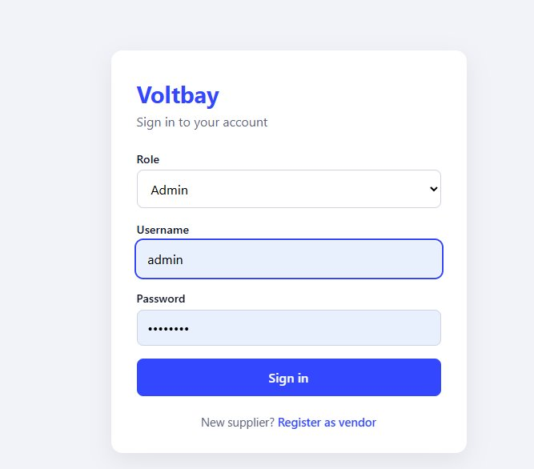
Login Page
Insert Login page screenshot here

Slide 9
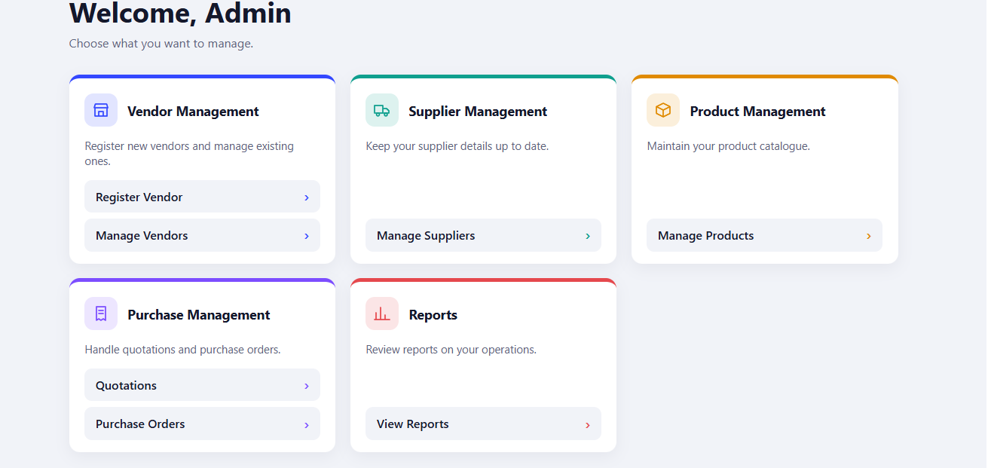
Admin Dashboard Page
Insert Admin Dashboard page screenshot here

Slide 10
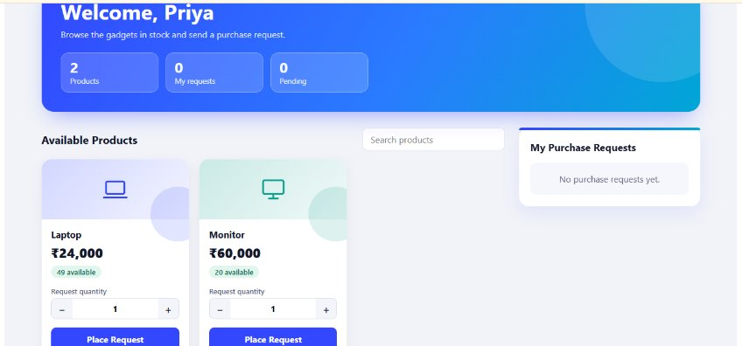
User Dashboard Page
Insert User Dashboard page screenshot here

Slide 11
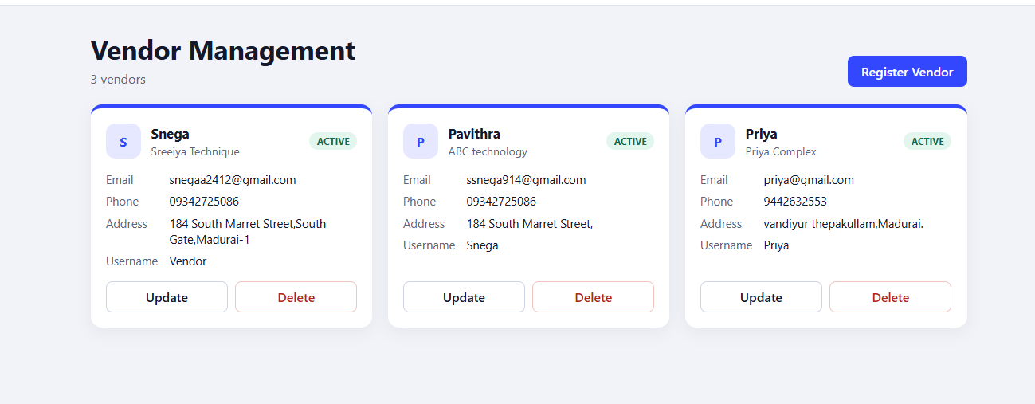
Vendors Page

Slide 12
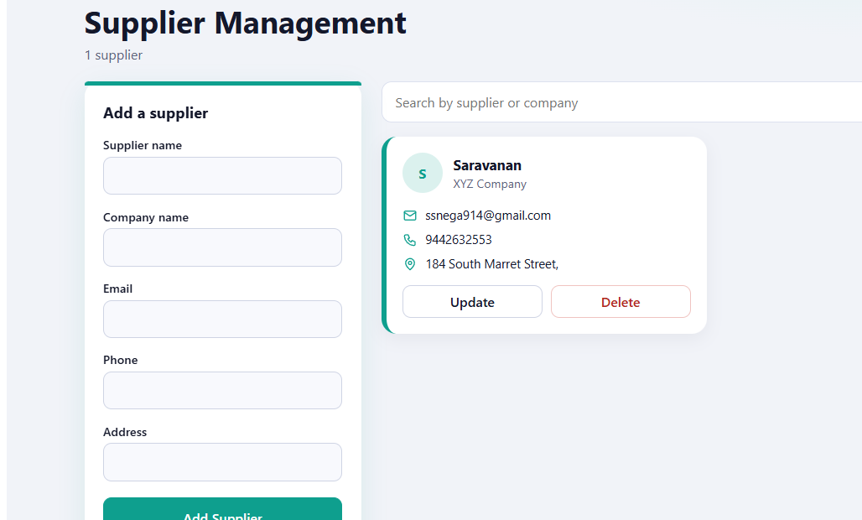
Suppliers Page
Insert Suppliers page screenshot here

Slide 13
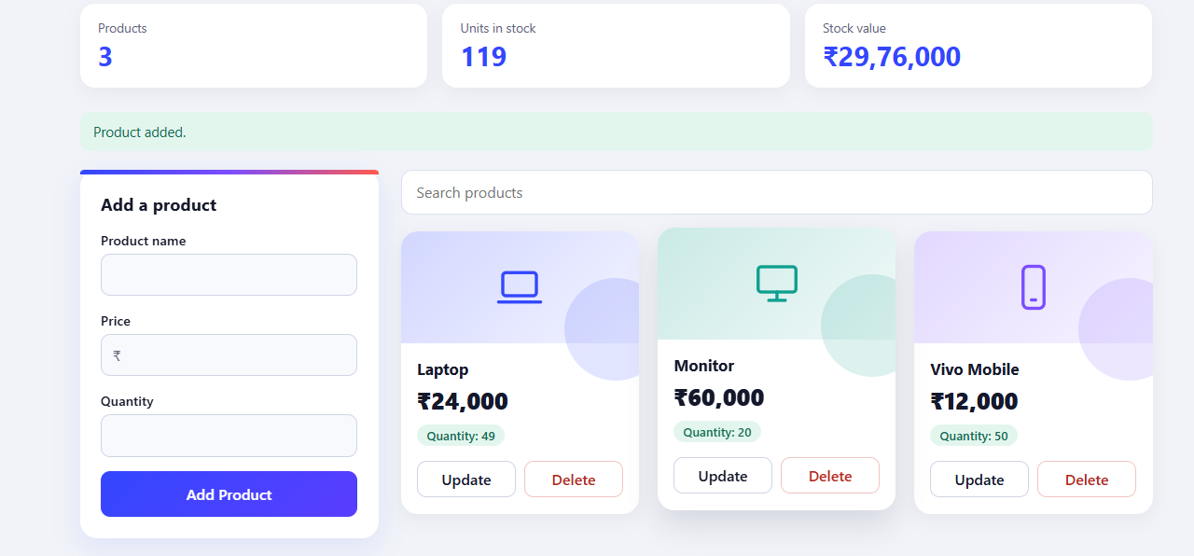
Products Page
Insert Products page screenshot here

Slide 14
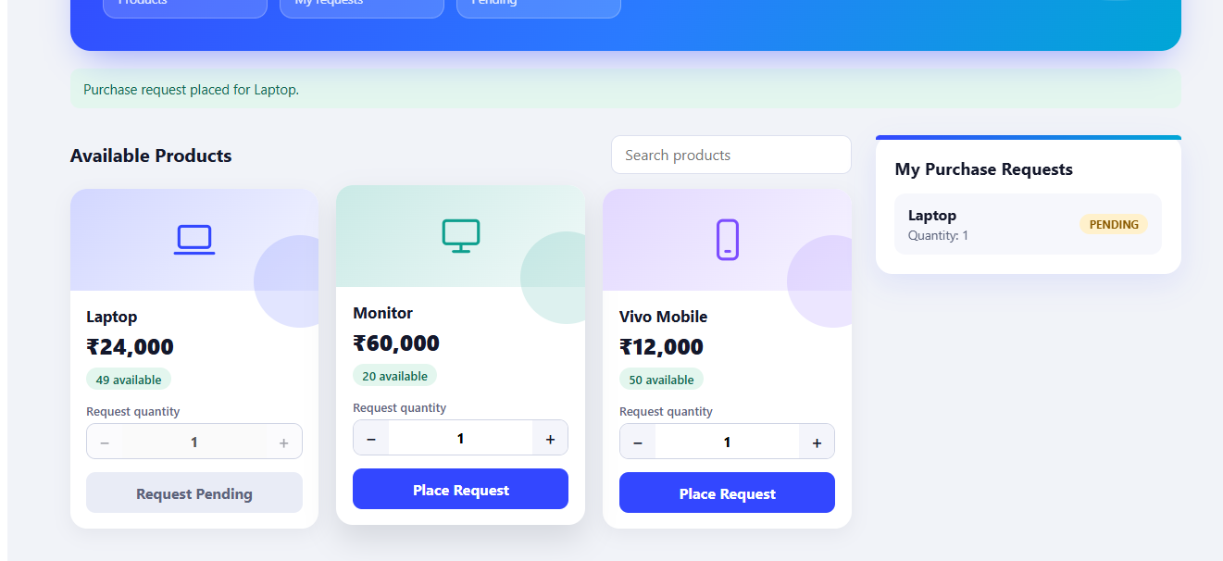
Purchase Requests Page
Insert Purchase Requests page screenshot here

Slide 15
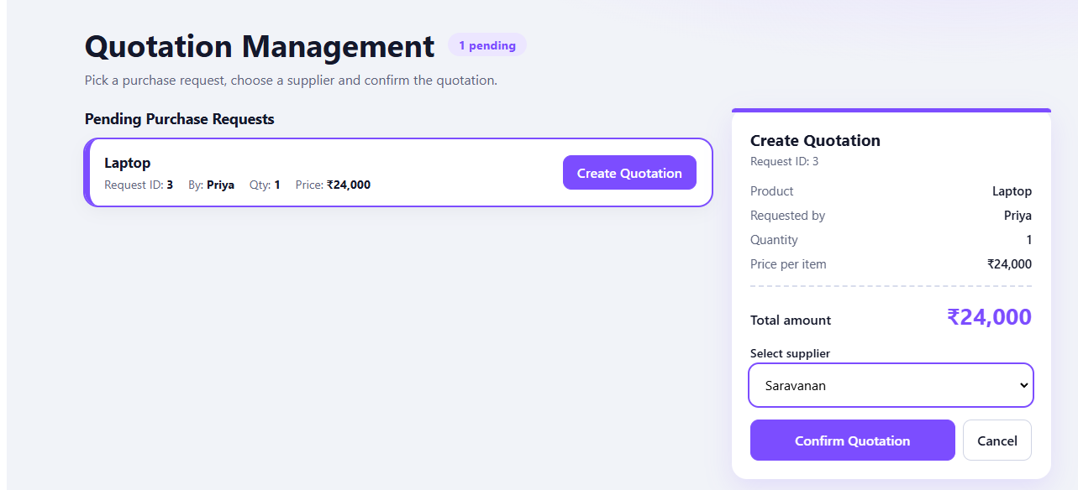
Quotations Page
Insert Quotations page screenshot here

Slide 16
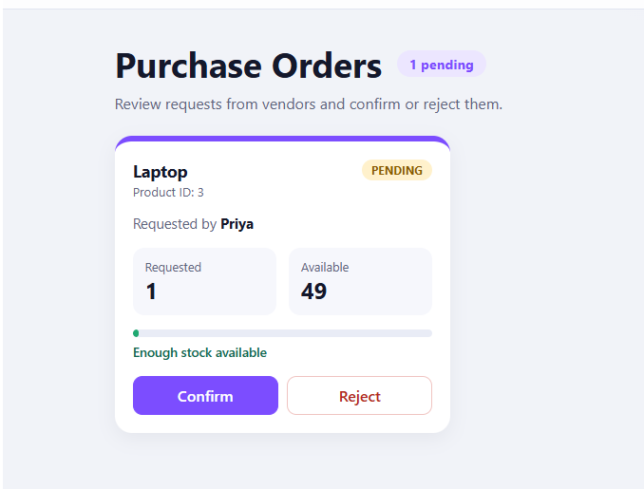
Purchase Orders Page
Insert Purchase Orders page screenshot here

Slide 17
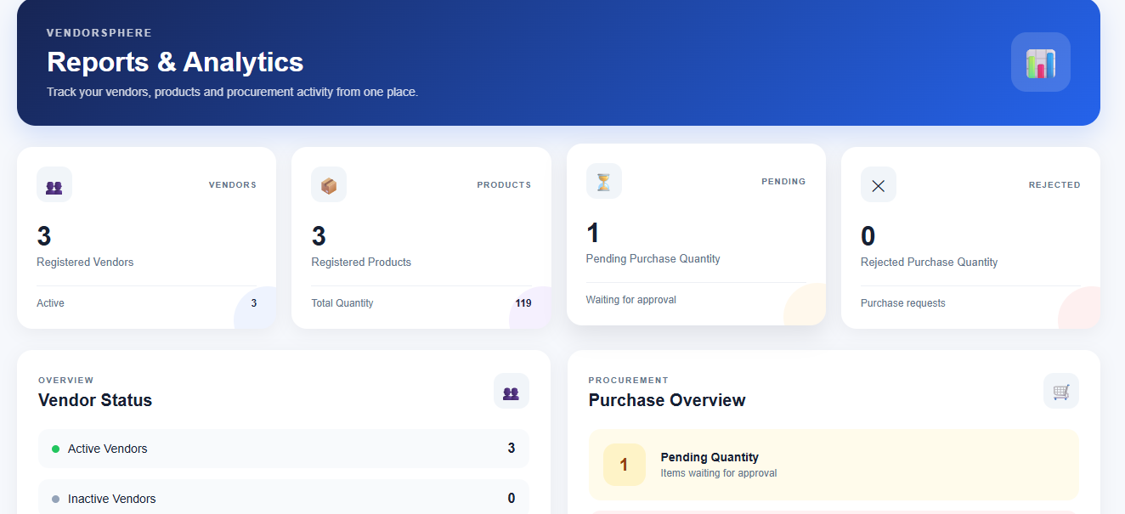
Reports Page
Insert Reports page screenshot here

Slide 18

Future Enhancements
Quotation comparison and approval workflow
Email/SMS alerts for requests and orders
Vendor performance ratings and categories
Payment and invoice tracking
Search, filter and pagination on all lists
Export reports to PDF and Excel
Audit logs of user actions
Docker deployment for backend and MySQL

Slide 19
Conclusion
The Vendor & Supplier Management System shows how a React.js frontend, Java Spring Boot REST APIs and a MySQL database work together in a practical application — covering role-based security, CRUD operations and the request-to-order workflow.
Thank You

